Slide 1
Public Key Systems

Slide 2
RSA
Invented by Cocks (GCHQ), independently, by Rivest, Shamir, Adleman (MIT)
Let p and q be two large prime numbers
Let N = pq be the modulus
Choose e relatively prime to (p−1)(q−1)
Find d so that ed = 1 (mod (p−1)(q−1))
Public key is (N,e)
Private key is d

Slide 3
RSA
To encrypt M compute: C = Me (mod N)
To decrypt C compute: M = C^{d} (mod N)
Recall that e and N are public
If attacker can factor N, can use e to easily find d since ed = 1 (mod (p−1)(q−1))
Factoring the modulus breaks RSA!
It is not known whether factoring is the only way to break RSA

Slide 4
Does RSA Really Work?
Given C = Me (mod N) we must show
M = C^{d} (mod N) = M^{ed} (mod N)
We use Euler’s Theorem:
If x is relatively prime to n then x^{ϕ(n)} = 1 (mod n)
Fact: ed = 1 (mod (p − 1)(q − 1))
Fact: ed = k(p − 1)(q − 1) + 1
Fact: ϕ(N) = (p − 1)(q − 1)
Fact: ed − 1 = k(p − 1)(q − 1) = kϕ(N)
M^{ed} = M^{(ed − 1) + 1} = M⋅M^{ed − 1} = M⋅M^{kϕ(N)} = M⋅(M^{ϕ(N)})^{k} = M⋅1^{k} = M (mod N)

Slide 5
Implementing RSA
Hence, if the RSA Cryptosystem is to be secure, it is certainly necessary that n = pq must be large enough that factoring it will be computationally infeasible.
Current factoring algorithms are able to factor numbers having up to 193 decimal digits.
the number of bits in the binary representation of an integer is log₂10 times the number of decimal digits.

Slide 6
RSA lgorithm
RSA Factoring Challenge
Numbers are designated “RSA-XXXX”, where XXXX is the
number’s length in bits
Challenge Number Prize ($US) Status
RSA-576 (174 Digits) $10,000 Factored (Dec 2003)
RSA-640 (193 Digits) $20,000 Factored (Nov 2005)
RSA-704 (212 Digits) $30,000 Not Factored
RSA-768 (232 Digits) $50,000 Not Factored
RSA-896 (270 Digits) $75,000 Not Factored
RSA-1024 (309 Digits) $100,000 Not Factored
RSA-1536 (463 Digits) $150,000 Not Factored
RSA-2048 (617 Digits) $200,000 Not Factored
RSA-704
Decimal Digits: 212
74 03756 34795 61712 82804 67960 97429 57314 25931 88889
23128 90849 36232 63897 27650 34028 26627 68919 96419 62511
78439 95894 33050 21275 85370 11896 80982 86733 17327 31089
30900 55250 51168 77063 29907 23963 80786 71008 60969 62537
93465 05637 96359

Slide 7
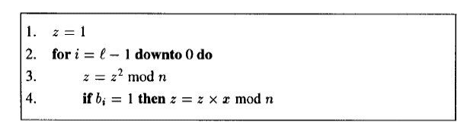
Implementing RSA
The square-and-multiply algorithm to compute z=x^{b} mod n
where
l = number of bits in binary representation of b
l = [log₂b]+1

Slide 8
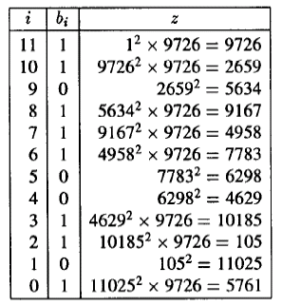
The square-and-multiply algorithm to compute x^{b} mod n (Example)
Example : Compute 9726³⁵³³ Mod 11413

Slide 9
Simple RSA Example
Example of RSA
Select “large” primes p = 11, q = 3
Then N = pq = 33 and (p−1)(q−1) = 20
Choose e = 3 (relatively prime to 20)
Find d such that ed = 1 (mod 20), we find that d = 7 works
Public key: (N, e) = (33, 3)
Private key: d = 7

Slide 10
Simple RSA Example
Public key: (N, e) = (33, 3)
Private key: d = 7
Suppose message M = 8
Ciphertext C is computed as
C = Me (mod N) = 8³ = 512 = 17 (mod 33)
Decrypt C to recover message:
M = C^{d} (mod N) = 17⁷ = 410,338,673
= 12,434,505 ∗ 33 + 8 = 8 (mod 33)

